Slide 1
Servlet Session Management
Session Management
<number>/23

Slide 2
Objectives
Maintaining state using session
+ Understand Web container model and Session
+ Store and Retrieve data to session
Session Management
<number>/23

Slide 3
Web Container Model
The servlet container is a compiled, executable program. The container is the intermediary between the Web server and the servlets in the container.
The container loads, initializes, and executes the servlets. When a request arrives, the container maps the request to a servlet, translates the request, and then passes the request to the servlet. The servlet processes the request and produces a response. The container translates the response into the network format, then sends the response back to the Web server.
Session Management
<number>/23

Slide 4
Web Container Model…
The container is designed to perform well while serving large numbers of requests.
A container can hold any number of active servlets, filters, and listeners.
Both the container and the objects in the container are multithreaded. The container creates and manages threads as necessary to handle incoming requests. The container handles multiple requests concurrently, and more than one thread may enter an object at a time. Therefore, each object within a container must be threadsafe.
Session Management
<number>/23

Slide 5
Web Container Model…
Fortunately, you are a web component developer, not a web container developer. So you can take for granted much of what is built into the web container. You are a consumer of what the web container provides—and have to understand the infrastructure only insofar as it affects your own business applications.
Session Management
<number>/23

Slide 6
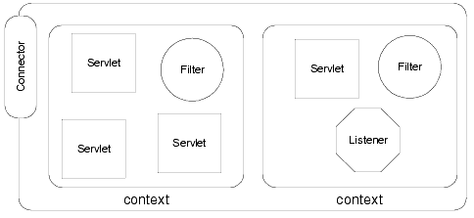
ServletContext
Session Management
<number>/23

Slide 7
ServletContext…
A servlet container can manage any number of distinct applications. An application consists of any number of servlets, filters, listeners, and static Web pages. A set of components working together is a Web application.
The container uses a context to group related components. The container loads the objects within a context as a group, and objects within the same context can easily share data.
Each context usually corresponds to a distinct Web application.
Session Management
<number>/23

Slide 8
ServletContext…
For example, the directory structure below describes two contexts, one named orders and one named catalog. The catalog context contains a static HTML page, intro.html.
webapps
  \orders
    \WEB-INF
      web.xml
  \catalog
  intro.html
  \WEB-INF
  web.xml
Session Management
<number>/23

Slide 9
ServletContext
Initialization Parameters
What if you want some fundamental information available to all the dynamic resources (servlets, JSPs) within your web application?
Session Management
<number>/23

Slide 10
ServletContext
Initialization Parameters…
Setting Up the Deployment Descriptor (web.xml)
<web-app>
  <context-param>
      <param-name>machineName</param-name>
      <param-value>GERALDINE</param-value
  </context-param>
<context-param>
    <param-name>secretParameterFile</param-name>
    <param-value>/WEB-INF/xml/secretParms.xml</param-value>
</context-param>
</web-app>
ServletContext.getInitParameter()
Session Management
<number>/23

Slide 11
ServletContext
Initialization Parameters…
Writing Code to Retrieve ServletContext Initialization Parameters
ServletContext sc = getServletContext();
String database = sc.getInitParameter("machineName");
String secret = sc.getInitParameter("secretParameterFile");
Session Management
<number>/23

Slide 12
ServletConfig Initialization Parameters
Setting Up the Deployment Descriptor (web.xml)
<servlet>
<servlet-name>InitParamaters</servlet-name>
<servlet-class>InitParamaters</servlet-class>
<init-param>
<param-name>name</param-name>
<param-value>FPT University</param-value>
</init-param>
</servlet>
ServletConfig.getInitParameter()
Session Management
<number>/23

Slide 13
ServletConfig Initialization Parameters…
Writing Code to Retrieve ServletConfig Initialization Parameters
ServletConfig sc = getServletConfig();
String name = sc.getInitParameter(“name");
Session Management
<number>/23

Slide 14
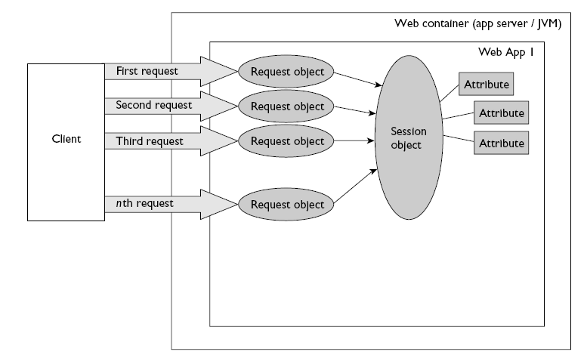
Session Life Cycle
Session Management
<number>/23

Slide 15
Session Death
HttpSession.invalidate() : Invalidates this session then unbinds any objects bound to it.
Time-out : The time-out value is controlled in one of three ways:
    Application Server Global Default
    Web Application Default
      <web-app>
      <session-config>
      <session-timeout>60</session-timeout>
      </session-config>
      </web-app>
    Individual Session Setting
      On obtaining a session, your servlet code can set the time-out value for that individual session only using the HttpSession.setMaxInactiveInterval(int seconds) API.
      An interval value of zero or less indicates that the session should never timeout.
Session Management
<number>/23

Slide 16
Session Management
There are two principal methods for session management “officially” recognized by the servlet API. One method is management by cookie exchange, and the other is management by rewriting URLs.
Session Management
<number>/23

Slide 17
Session Management: General Principles
Each of these requests needs to carry a unique ID, which identifies the session to which it belongs.
The web application will allocate this unique ID on the first request from the client.
The ID must be passed back to the client so that the client can pass it back again with its next request. In this way, the web application will know to which session the request belongs. This implies that the client must need to store the unique ID somewhere—and that’s where session management mechanisms come in.
Session Management
<number>/23

Slide 18
Cookies
The preferred way for a web application to pass session IDs back to a client is via a cookie in the response. This is a small text file that the client stores somewhere. Storage can be on disk or memory.
In the case of J2EE web applications, the cookie returned has a standard name JSESSIONID and store in memory.
Session Management
<number>/23

Slide 19
URL Rewriting
A “pseudo-parameter” called jsessionid is placed in the URL between the servlet name (with path information, if present) and the query string.
Example:
http://localhost:8080/examp0401/SessionExample;jsessionid= 58112645388D9380808A726A27F92997?name=value
Session Management
<number>/23

Slide 20
Summary
Web Container Model
  ServletContext
Sessions and Listeners
  Session Life Cycle
  Session Management
Session Management
<number>/23

